Slide 1

Dimensionality Reduction: SVD
Note to other teachers and users of these slides: We would be delighted if you found our
material useful for giving your own lectures. Feel free to use these slides verbatim, or to
modify them to fit your own needs. If you make use of a significant portion of these slides
in your own lecture, please include this message, or a link to our web site: http://www.mmds.org
CS246: Mining Massive Datasets
Jure Leskovec, Stanford University
Mina Ghashami, Amazon
http://cs246.stanford.edu

Slide 2


Reducing Matrix Dimension
Often, our data can be represented by an $m$-by-$n$ matrix
And this matrix can be closely approximated by the product of three matrices that share a small common dimension $r$
n
r
r
n
A
U
×
Σ
×
V^{T}
r
m
$$≈$$
m

Slide 3
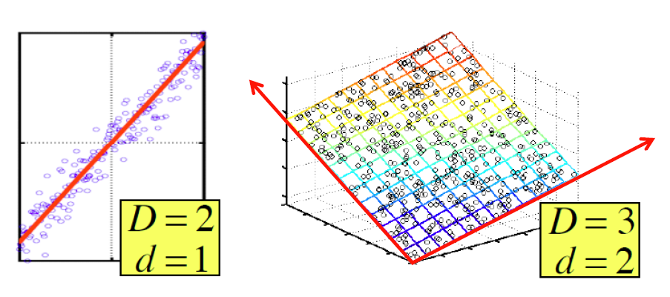
Dimensionality Reduction
There are hidden, or latent factors, latent dimensions that – to a close approximation – explain why the values are as they appear in the data matrix

Slide 4
Dimensionality Reduction
The axes of these dimensions can be chosen by:
The first dimension is the direction in which the points exhibit the greatest variance
The second dimension is the direction, orthogonal to the first, in which points show the 2nd greatest variance
And so on…, until you have enough dimensions that variance is really low

Slide 5
SVD: Singular Value Decomposition

Slide 6
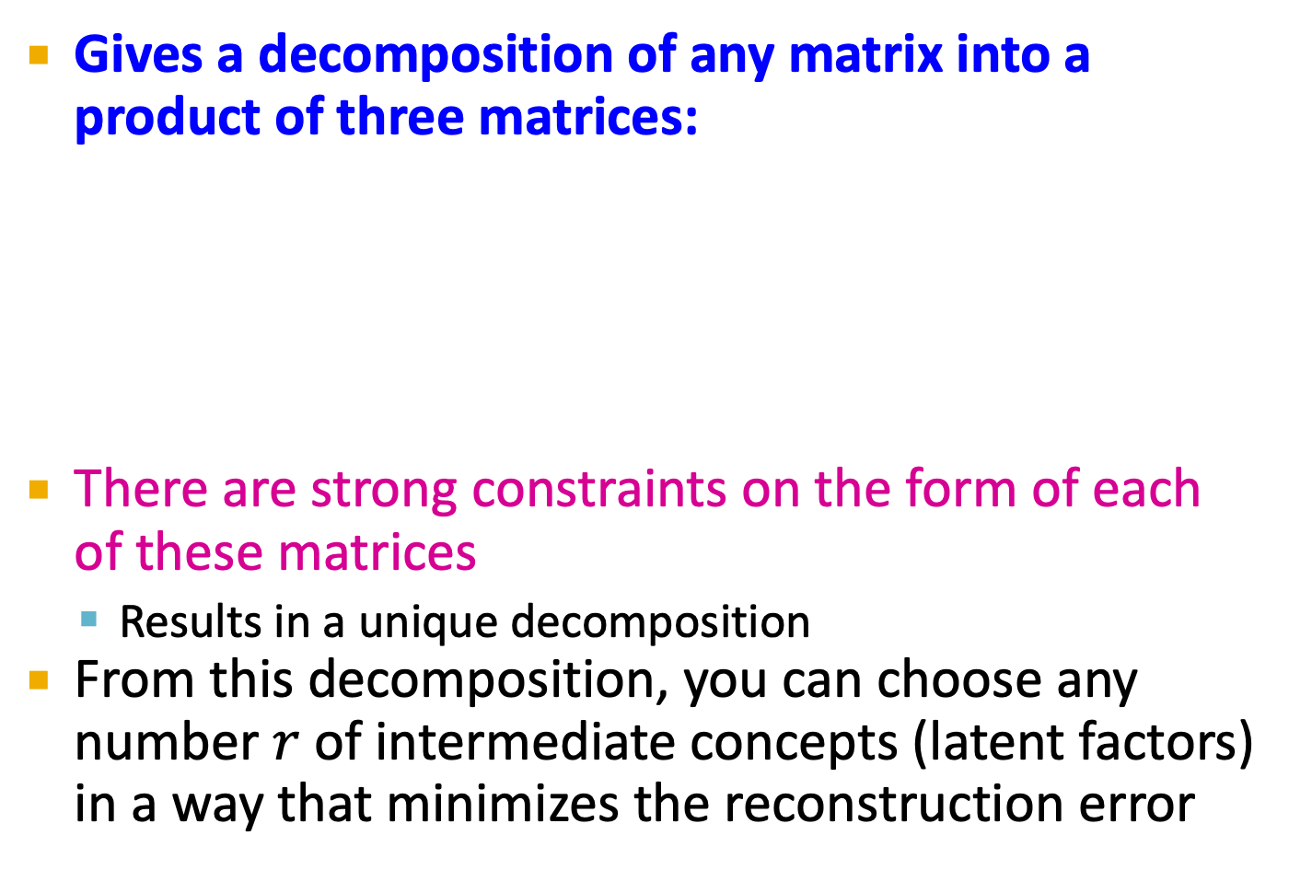
Reducing Matrix Dimension
Gives a decomposition of any matrix into a product of three matrices:
There are strong constraints on the form of each of these matrices
Results in a unique decomposition
From this decomposition, you can choose any number $r$ of intermediate concepts (latent factors) in a way that minimizes the reconstruction error
n
r
r
n
A
U
×
Σ
×
V^{T}
r
m
~
m

Slide 7
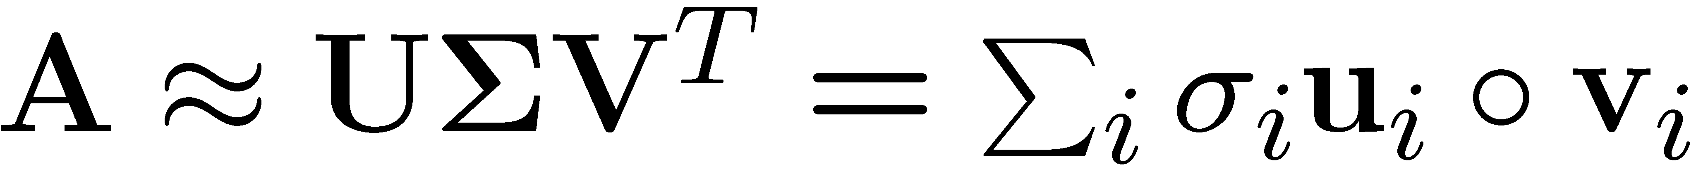
SVD – Definition
T
n
r
r
n
r
A
≈
Σ
V^{T}
m
m
U
A: Input data matrix
m x n matrix (e.g., m documents, n terms)
U: Left singular vectors
m x r matrix (m documents, r concepts)
Σ: Singular values
r x r diagonal matrix (strength of each ‘concept’) (r : rank of the matrix A)
V: Right singular vectors
n x r matrix (n terms, r concepts)

Slide 8
SVD
T
n
u₁σ₁v₁
u₂σ₂v₂
A
≈
m
+
σ_{i} … scalar
u_{i} … vector
v_{i} … vector
If we set σ₂ = 0, then the green
columns may as well not exist.

Slide 9
SVD – Properties
It is always possible to decompose a real matrix A into A = U Σ V^{T} , where
U, Σ, V: unique
U, V: column orthonormal
U^{T} U = I; V^{T} V = I (I: identity matrix)
(Columns are orthogonal unit vectors)
Σ: diagonal
Entries (singular values) are non-negative, and sorted in decreasing order (σ₁ ≥ σ₂ ≥ ... ≥ 0)
Nice proof of uniqueness: https://www.cs.cornell.edu/courses/cs322/2008sp/stuff/TrefethenBau_Lec4_SVD.pdf

Slide 10
SVD – Example: Users-to-Movies
Consider a matrix. What does SVD do?
Matrix
Alien
Serenity
Casablanca
Amelie
n
1 1 1 0 0
3 3 3 0 0
4 4 4 0 0
5 5 5 0 0
0 2 0 4 4
0 0 0 5 5
0 1 0 2 2
SciFi
Σ
V^{T}
=
m
Romance
U
“Concepts” AKA Latent dimensions AKA Latent factors
Ratings matrix where each column corresponds to a movie and each row to a user. First 4 users prefer SciFi, while others prefer Romance.

Slide 11
SVD – Example: Users-to-Movies
A = U Σ V^{T} - example: Users to Movies
Matrix
Alien
Serenity
Casablanca
Amelie
1 1 1 0 0
3 3 3 0 0
4 4 4 0 0
5 5 5 0 0
0 2 0 4 4
0 0 0 5 5
0 1 0 2 2
0.13 0.02 -0.01
0.41 0.07 -0.03
0.55 0.09 -0.04
0.68 0.11 -0.05
0.15 -0.59 0.65
0.07 -0.73 -0.67
0.07 -0.29 0.32
SciFi
12.4 0 0
0 9.5 0
0 0 1.3
=
x
x
Romance
0.56 0.59 0.56 0.09 0.09
0.12 -0.02 0.12 -0.69 -0.69
0.40 -0.80 0.40 0.09 0.09

Slide 12
SVD – Example: Users-to-Movies
A = U Σ V^{T} - example: Users to Movies
Matrix
Alien
Serenity
Casablanca
Amelie
1 1 1 0 0
3 3 3 0 0
4 4 4 0 0
5 5 5 0 0
0 2 0 4 4
0 0 0 5 5
0 1 0 2 2
0.13 0.02 -0.01
0.41 0.07 -0.03
0.55 0.09 -0.04
0.68 0.11 -0.05
0.15 -0.59 0.65
0.07 -0.73 -0.67
0.07 -0.29 0.32
SciFi
12.4 0 0
0 9.5 0
0 0 1.3
=
x
x
Romance
0.56 0.59 0.56 0.09 0.09
0.12 -0.02 0.12 -0.69 -0.69
0.40 -0.80 0.40 0.09 0.09

Slide 13
SVD – Example: Users-to-Movies
U is “user-to-concept”
factor matrix
A = U Σ V^{T} - example:
Matrix
Alien
Serenity
Casablanca
Amelie
1 1 1 0 0
3 3 3 0 0
4 4 4 0 0
5 5 5 0 0
0 2 0 4 4
0 0 0 5 5
0 1 0 2 2
0.13 0.02 -0.01
0.41 0.07 -0.03
0.55 0.09 -0.04
0.68 0.11 -0.05
0.15 -0.59 0.65
0.07 -0.73 -0.67
0.07 -0.29 0.32
SciFi
12.4 0 0
0 9.5 0
0 0 1.3
=
x
x
Romance
0.56 0.59 0.56 0.09 0.09
0.12 -0.02 0.12 -0.69 -0.69
0.40 -0.80 0.40 0.09 0.09

Slide 14
SVD – Example: Users-to-Movies
A = U Σ V^{T} - example:
Matrix
Alien
Serenity
Casablanca
Amelie
SciFi-concept
“strength” of the SciFi-concept
1 1 1 0 0
3 3 3 0 0
4 4 4 0 0
5 5 5 0 0
0 2 0 4 4
0 0 0 5 5
0 1 0 2 2
0.13 0.02 -0.01
0.41 0.07 -0.03
0.55 0.09 -0.04
0.68 0.11 -0.05
0.15 -0.59 0.65
0.07 -0.73 -0.67
0.07 -0.29 0.32
SciFi
SciFi
12.4 0 0
0 9.5 0
0 0 1.3
=
x
x
Romance
0.56 0.59 0.56 0.09 0.09
0.12 -0.02 0.12 -0.69 -0.69
0.40 -0.80 0.40 0.09 0.09

Slide 15
SVD – Example: Users-to-Movies
A = U Σ V^{T} - example:
Matrix
Alien
Serenity
Casablanca
Amelie
V is “movie-to-concept”
factor matrix
SciFi-concept
1 1 1 0 0
3 3 3 0 0
4 4 4 0 0
5 5 5 0 0
0 2 0 4 4
0 0 0 5 5
0 1 0 2 2
0.13 0.02 -0.01
0.41 0.07 -0.03
0.55 0.09 -0.04
0.68 0.11 -0.05
0.15 -0.59 0.65
0.07 -0.73 -0.67
0.07 -0.29 0.32
SciFi
12.4 0 0
0 9.5 0
0 0 1.3
=
x
x
Romance
0.56 0.59 0.56 0.09 0.09
0.12 -0.02 0.12 -0.69 -0.69
0.40 -0.80 0.40 0.09 0.09

Slide 16
SVD – Interpretation #1
Movies, users and concepts:
U: user-to-concept matrix
V: movie-to-concept matrix
Σ: its diagonal elements: ‘strength’ of each concept

Slide 17
Dimensionality Reduction with SVD

Slide 18
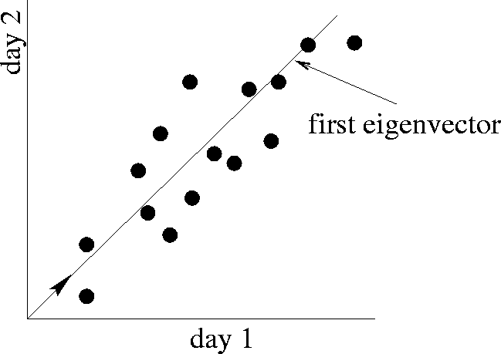
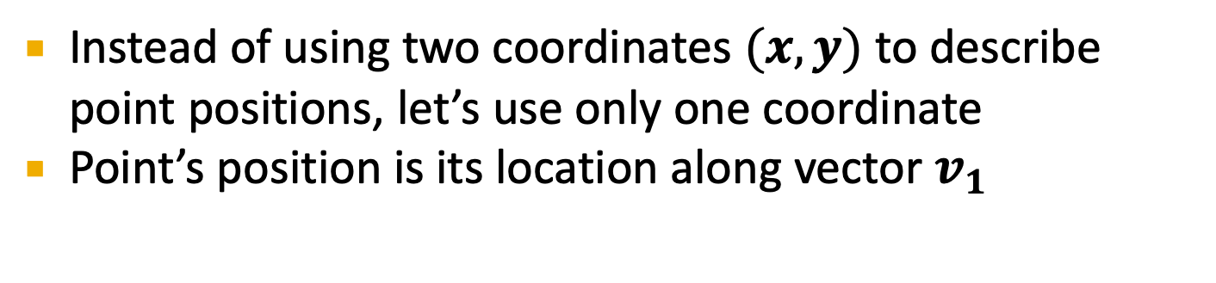
SVD – Dimensionality Reduction
Movie 2 rating
first right singular vector
v₁
Movie 1 rating
Instead of using two coordinates $(x,y)$ to describe point positions, let’s use only one coordinate
Point’s position is its location along vector $v_{1}$

Slide 19
SVD – Dimensionality Reduction
A = U Σ V^{T} - example:
U: “user-to-concept” matrix
V: “movie-to-concept” matrix
Movie 2 rating
first right singular vector
v₁
1 1 1 0 0
3 3 3 0 0
4 4 4 0 0
5 5 5 0 0
0 2 0 4 4
0 0 0 5 5
0 1 0 2 2
0.13 0.02 -0.01
0.41 0.07 -0.03
0.55 0.09 -0.04
0.68 0.11 -0.05
0.15 -0.59 0.65
0.07 -0.73 -0.67
0.07 -0.29 0.32
Movie 1 rating
12.4 0 0
0 9.5 0
0 0 1.3
=
x
x
0.56 0.59 0.56 0.09 0.09
0.12 -0.02 0.12 -0.69 -0.69
0.40 -0.80 0.40 0.09 0.09

Slide 20
SVD – Dimensionality Reduction
A = U Σ V^{T} - example:
Movie 2 rating
first right singular vector
variance (‘spread’) on the v₁ axis
v₁
1 1 1 0 0
3 3 3 0 0
4 4 4 0 0
5 5 5 0 0
0 2 0 4 4
0 0 0 5 5
0 1 0 2 2
0.13 0.02 -0.01
0.41 0.07 -0.03
0.55 0.09 -0.04
0.68 0.11 -0.05
0.15 -0.59 0.65
0.07 -0.73 -0.67
0.07 -0.29 0.32
Movie 1 rating
12.4 0 0
0 9.5 0
0 0 1.3
=
x
x
0.56 0.59 0.56 0.09 0.09
0.12 -0.02 0.12 -0.69 -0.69
0.40 -0.80 0.40 0.09 0.09

Slide 21
SVD – Dimensionality Reduction
A = U Σ V^{T} - example:
U Σ: Gives the coordinates of the points in the projection axis
Movie 2 rating
first right singular vector
v₁
1 1 1 0 0
3 3 3 0 0
4 4 4 0 0
5 5 5 0 0
0 2 0 4 4
0 0 0 5 5
0 1 0 2 2
Projection of users on the “Sci-Fi” axis U Σ:
Movie 1 rating
1.61 0.19 -0.01
5.08 0.66 -0.03
6.82 0.85 -0.05
8.43 1.04 -0.06
1.86 -5.60 0.84
0.86 -6.93 -0.87
0.86 -2.75 0.41

Slide 22
A = USV^{T}
A is 7*5 (7 data points in 5-dim space)
U is 7*3, S is 3*3 and V is 5*3
Project data points onto V:
AV = USV^{T} V = US → AV is 7*3 → reduced dim from 5 to 3

Slide 23
SVD :
A = USV^{T}
A is m*n → U is m*m, V is n*n and S is m*n
If A is full rank , above holds
If A is not full rank, A = USV^{T}
U is m*r , V is r*n and S is r*r

Slide 24
SVD – Interpretation #2
More details
Q: How is dim. reduction done?
1 1 1 0 0
3 3 3 0 0
4 4 4 0 0
5 5 5 0 0
0 2 0 4 4
0 0 0 5 5
0 1 0 2 2
0.13 0.02 -0.01
0.41 0.07 -0.03
0.55 0.09 -0.04
0.68 0.11 -0.05
0.15 -0.59 0.65
0.07 -0.73 -0.67
0.07 -0.29 0.32
12.4 0 0
0 9.5 0
0 0 1.3
=
x
x
0.56 0.59 0.56 0.09 0.09
0.12 -0.02 0.12 -0.69 -0.69
0.40 -0.80 0.40 0.09 0.09

Slide 25
SVD – Interpretation #2
More details
Q: How exactly is dim. reduction done?
A: Set smallest singular values to zero
1 1 1 0 0
3 3 3 0 0
4 4 4 0 0
5 5 5 0 0
0 2 0 4 4
0 0 0 5 5
0 1 0 2 2
0.13 0.02 -0.01
0.41 0.07 -0.03
0.55 0.09 -0.04
0.68 0.11 -0.05
0.15 -0.59 0.65
0.07 -0.73 -0.67
0.07 -0.29 0.32
12.4 0 0
0 9.5 0
0 0 1.3
=
x
x
0.56 0.59 0.56 0.09 0.09
0.12 -0.02 0.12 -0.69 -0.69
0.40 -0.80 0.40 0.09 0.09

Slide 26
SVD – Interpretation #2
More details
Q: How exactly is dim. reduction done?
A: Set smallest singular values to zero
1 1 1 0 0
3 3 3 0 0
4 4 4 0 0
5 5 5 0 0
0 2 0 4 4
0 0 0 5 5
0 1 0 2 2
0.13 0.02 -0.01
0.41 0.07 -0.03
0.55 0.09 -0.04
0.68 0.11 -0.05
0.15 -0.59 0.65
0.07 -0.73 -0.67
0.07 -0.29 0.32
12.4 0 0
0 9.5 0
0 0 1.3
≈
x
x
0.56 0.59 0.56 0.09 0.09
0.12 -0.02 0.12 -0.69 -0.69
0.40 -0.80 0.40 0.09 0.09

Slide 27
SVD – Interpretation #2
This is Rank 2 approximation to A. We could also do Rank 1 approx.
The larger the rank the more accurate the approximation.
More details
Q: How exactly is dim. reduction done?
A: Set smallest singular values to zero
1 1 1 0 0
3 3 3 0 0
4 4 4 0 0
5 5 5 0 0
0 2 0 4 4
0 0 0 5 5
0 1 0 2 2
0.13 0.02 -0.01
0.41 0.07 -0.03
0.55 0.09 -0.04
0.68 0.11 -0.05
0.15 -0.59 0.65
0.07 -0.73 -0.67
0.07 -0.29 0.32
12.4 0 0
0 9.5 0
0 0 1.3
≈
x
x
0.56 0.59 0.56 0.09 0.09
0.12 -0.02 0.12 -0.69 -0.69
0.40 -0.80 0.40 0.09 0.09

Slide 28
SVD – Interpretation #2
This is Rank 2 approximation to A. We could also do Rank 1 approx.
The larger the rank the more accurate the approximation.
More details
Q: How exactly is dim. reduction done?
A: Set smallest singular values to zero
1 1 1 0 0
3 3 3 0 0
4 4 4 0 0
5 5 5 0 0
0 2 0 4 4
0 0 0 5 5
0 1 0 2 2
0.13 0.02
0.41 0.07
0.55 0.09
0.68 0.11
0.15 -0.59
0.07 -0.73
0.07 -0.29
12.4 0
0 9.5
≈
x
x
0.56 0.59 0.56 0.09 0.09
0.12 -0.02 0.12 -0.69 -0.69

Slide 29
A ~ USV^{T}
Projection into 2-dim: AV^{T} → 7*2
Or you can do: U^{T}A → 2*5

Slide 30
SVD – Interpretation #2
This is Rank 2 approximation to A. We could also do Rank 1 approx.
The larger the rank the more accurate the approximation
More details
Q: How exactly is dim. reduction done?
A: Set smallest singular values to zero
1 1 1 0 0
3 3 3 0 0
4 4 4 0 0
5 5 5 0 0
0 2 0 4 4
0 0 0 5 5
0 1 0 2 2
0.92 0.95 0.92 0.01 0.01
2.91 3.01 2.91 -0.01 -0.01
3.90 4.04 3.90 0.01 0.01
4.82 5.00 4.82 0.03 0.03
0.70 0.53 0.70 4.11 4.11
-0.69 1.34 -0.69 4.78 4.78
0.32 0.23 0.32 2.01 2.01
≈
Reconstructed data matrix B
Reconstruction Error is quantified by the Frobenius norm:
ǁMǁ_{F} = √Σ_{ij} M_{ij}²
ǁA-Bǁ_{F} = √ Σ_{ij} (A_{ij}-B_{ij})²
^{is “small”}

Slide 31
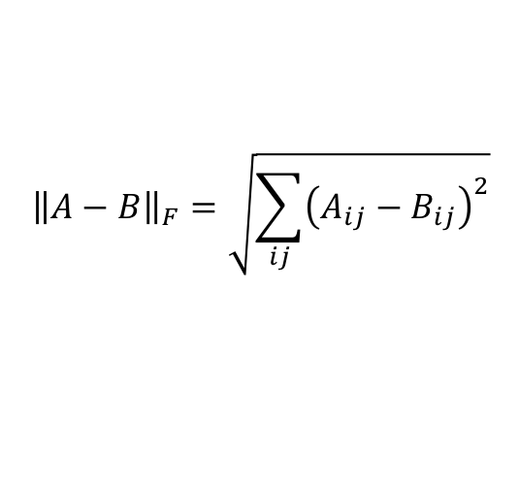
SVD – Best Low Rank Approx.
Fact: SVD gives ‘best’ axis to project on:
‘best’ = minimizing the sum of reconstruction errors
U
$${\left\|A−B\right\|}_{F}=\sqrt{\sum_{ij}{{\left(A_{ij}−B_{ij}\right)}^{2}}}$$
A
Sigma
=
V^{T}
B is best approximation of A:
B
U
Sigma
=
V^{T}

Slide 32
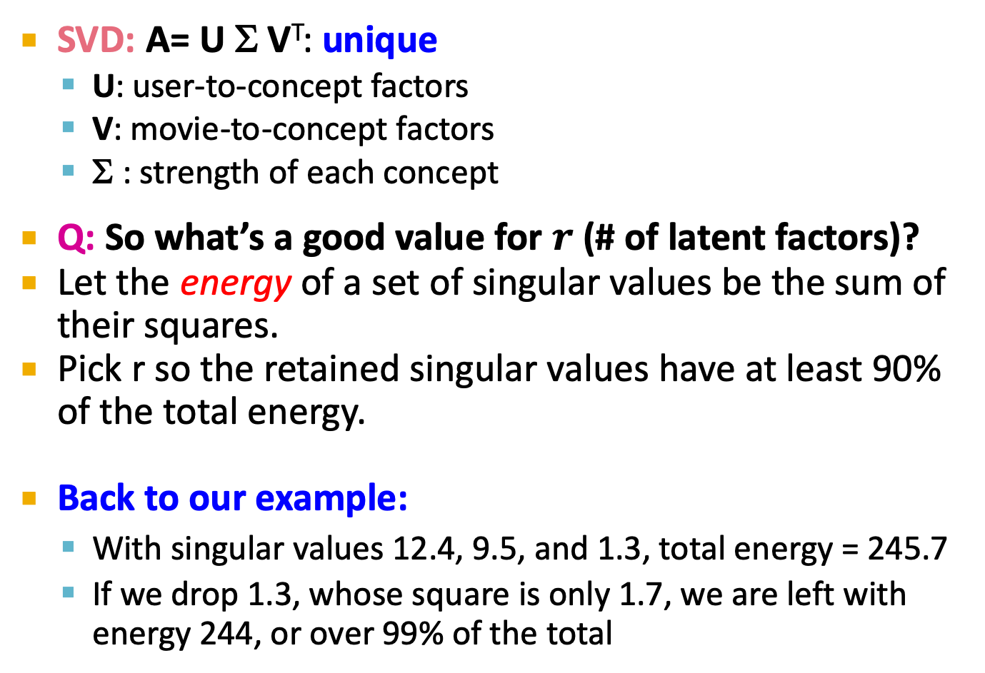
SVD – Conclusions so far
SVD: A= U Σ V^{T}: unique
U: user-to-concept factors
V: movie-to-concept factors
Σ : strength of each concept
Q: So what’s a good value for $r$ (# of latent factors)?
Let the energy of a set of singular values be the sum of their squares.
Pick r so the retained singular values have at least 90% of the total energy.
Back to our example:
With singular values 12.4, 9.5, and 1.3, total energy = 245.7
If we drop 1.3, whose square is only 1.7, we are left with energy 244, or over 99% of the total

Slide 33
How to Compute SVD

Slide 34
If A is symmetric → SVD : A= USU^{T}
Eigen Decomposition = SVD for symmetric matrices
A= USU^{T} → AU = USU^{T}U = US --> U^{T}AU = U^{T}US = S
U^{T}AU = S → eigen values

Slide 35
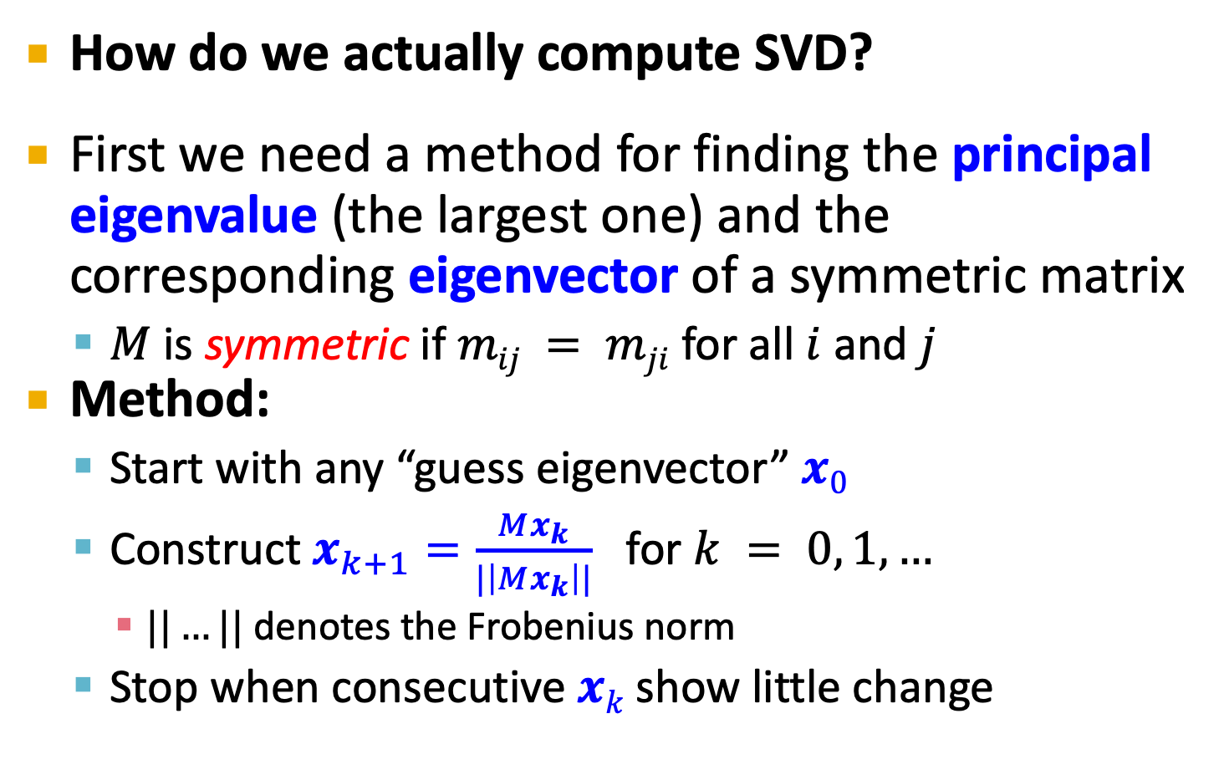
Finding Eigenpairs
How do we actually compute SVD?
First we need a method for finding the principal eigenvalue (the largest one) and the corresponding eigenvector of a symmetric matrix
$M$ is symmetric if $mij = mji$ for all $i$ and $j$
Method:
Start with any “guess eigenvector” $x0$
Construct $x_{k+1}=\frac{Mx_{k}}{|\left|Mx_{k}\right||}$ for $k = 0, 1,…$
$||…||$ denotes the Frobenius norm
Stop when consecutive $xk$ show little change

Slide 36
Example: Iterative Eigenvector
2
2 3
1
1
M =
x₀ =
Mx₀
3
5
0.51
0.86
=
/√34
=
=
x₁
||Mx₀||
Mx₁
2.23
3.60
0.53
0.85
=
/√17.93
=
=
x₂
||Mx₁||
…..

Slide 37
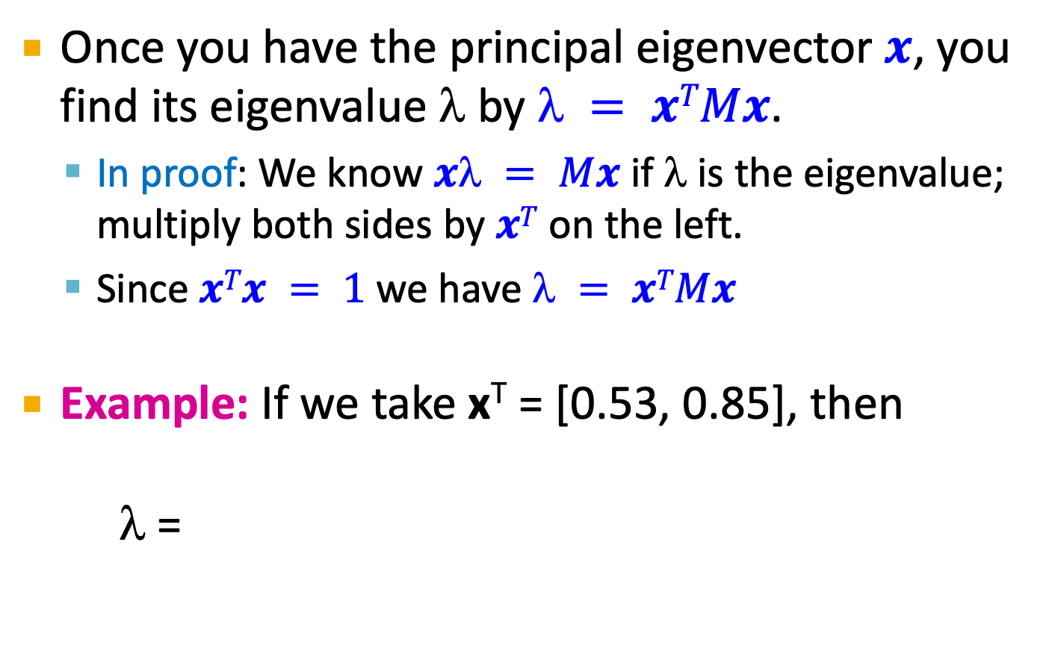
Finding the Principal Eigenvalue
Once you have the principal eigenvector $x$, you find its eigenvalue $$ by $ = xTMx$.
In proof: We know $x = Mx$ if $$ is the eigenvalue; multiply both sides by $xT$ on the left.
Since $xTx = 1$we have $ = xTMx$
Example: If we take x^{T} = [0.53, 0.85], then
λ =
[
2
2 3
]
[
]
0.53
0.85
[0.53 0.85]
= 4.25

Slide 38
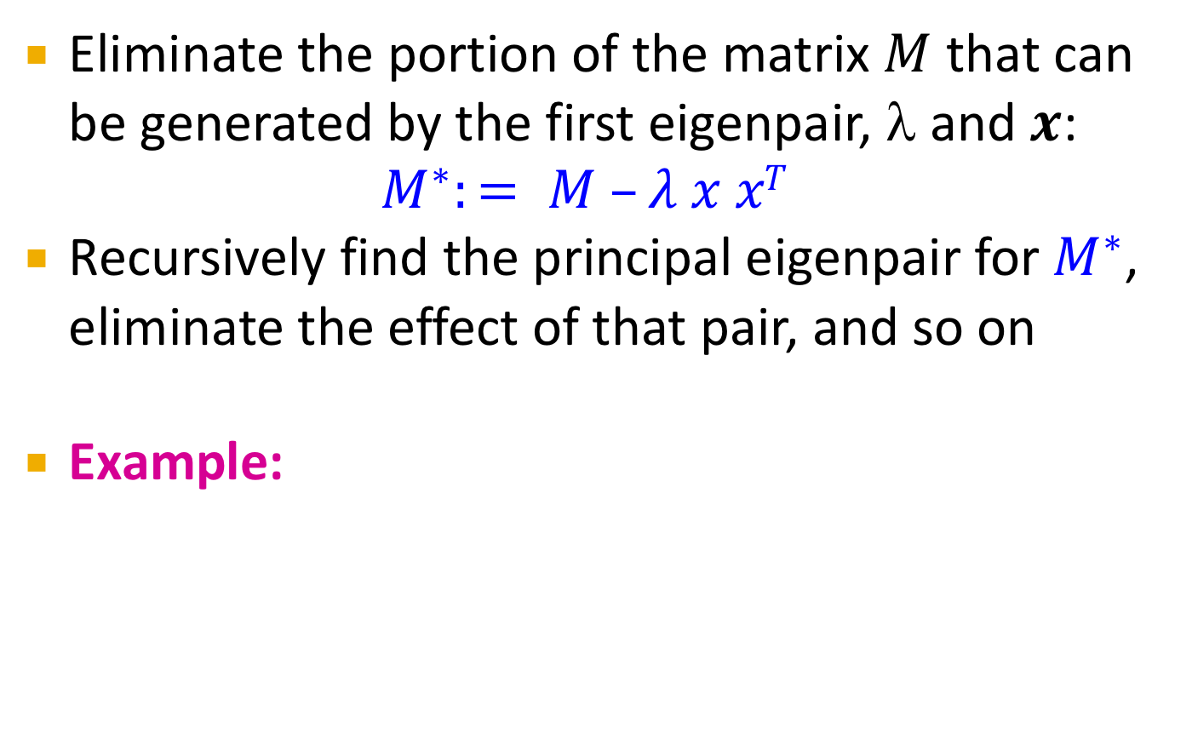
Finding More Eigenpairs
Eliminate the portion of the matrix $M$ that can be generated by the first eigenpair, λ and $x$:
$$M^{∗}:= M –λ x xT$$
Recursively find the principal eigenpair for $M^{∗}$, eliminate the effect of that pair, and so on
Example:
[
2
2 3
]
[
0.53
0.85
]
[
-0.19 0.09
0.09 0.07
]
M* =
– 4.25
[0.53 0.85]
=

Slide 39
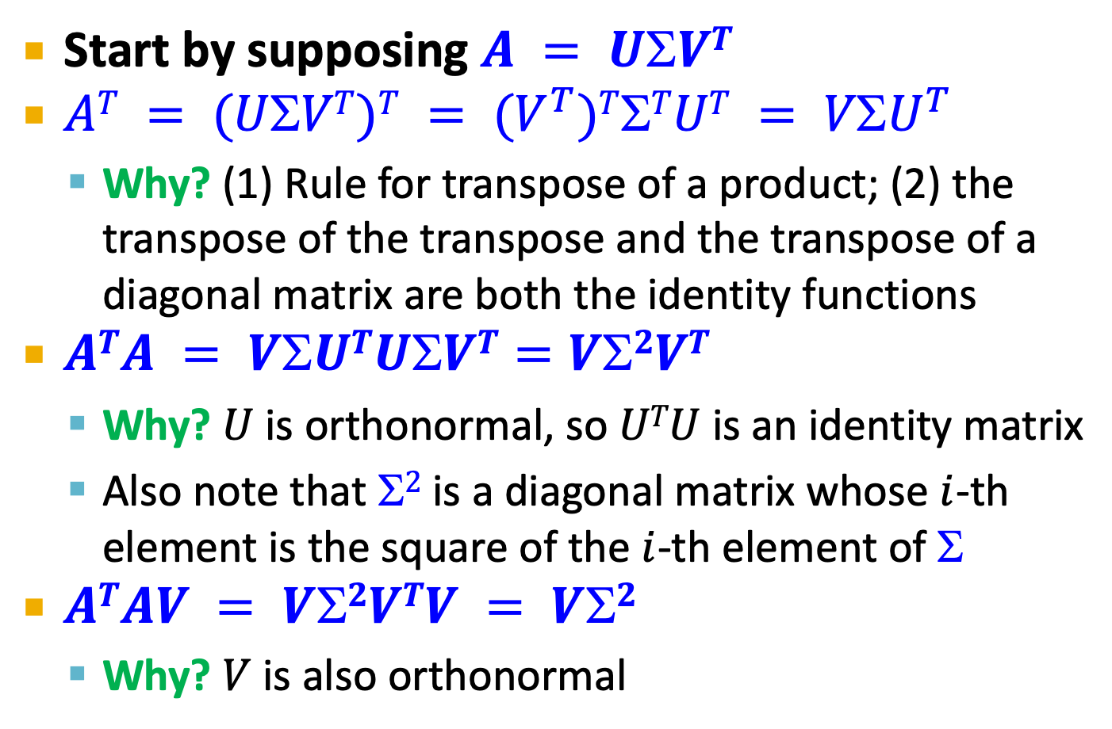
How to Compute the SVD
Start by supposing $A = UVT$
$AT = (UVT)T = (V^{T})TTUT = VU^{T}$
Why? (1) Rule for transpose of a product; (2) the transpose of the transpose and the transpose of a diagonal matrix are both the identity functions
$ATA = VUTUVT=V2VT$
Why? $U$ is orthonormal, so $UTU$ is an identity matrix
Also note that $2$ is a diagonal matrix whose $i$-th element is the square of the $i$-th element of $$
$ATAV = V2VTV = V2$
Why? $V$ is also orthonormal

Slide 40
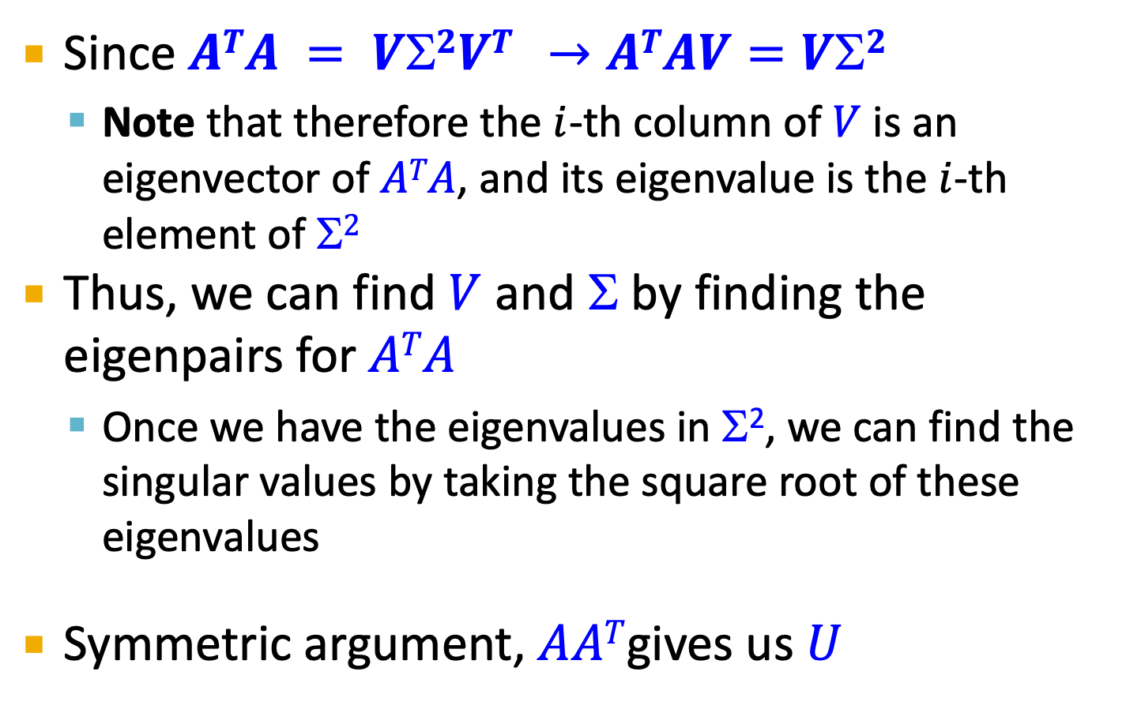
Computing the SVD –(2)
Since $ATA = V2VT →ATAV=V2$
Note that therefore the $i$-th column of $V$ is an eigenvector of $ATA$, and its eigenvalue is the $i$-th element of $2$
Thus, we can find $V$ and Σ by finding the eigenpairs for $ATA$
Once we have the eigenvalues in Σ², we can find the singular values by taking the square root of these eigenvalues
Symmetric argument, $AAT$gives us $U$

Slide 41
SVD – Complexity
To compute the full SVD using specialized methods:
O(nm²) or O(n²m) (whichever is less)
But:
Less work, if we just want singular values
or if we want the first k singular vectors
or if the matrix is sparse
Implemented in linear algebra packages like
LINPACK, Matlab, SPlus, Mathematica ...

